Slide 1
How do people with learning disabilities experience bereavement
Professor Sheila Baroness Hollins
Emeritus Professor of Psychiatry, St George's University of London
Founder and Chair, Beyond Words
Crossbench member, House of Lords
President Royal College of Occupational Therapists
President Royal Medical Benevolent Fund

Slide 2
Aims of research
Raising awareness and understanding of the needs of bereaved people
Finding an effective and practical therapeutic intervention to improve bereaved people’s health and wellbeing

Slide 3
Normal grief
Adjustment disorder
delayed grief
prolonged depressive reaction
mixed disturbance of emotion and conduct
onset of symptoms is within the first month
symptoms last for about 6 months

Slide 4
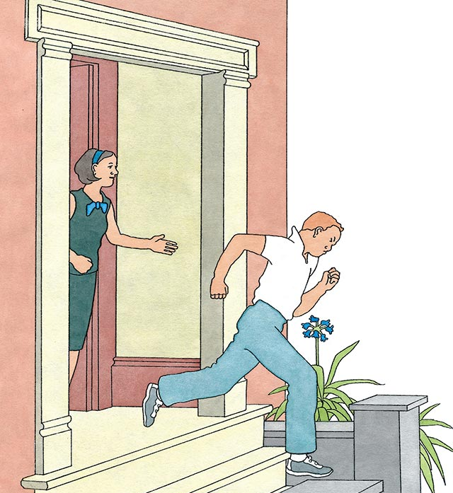
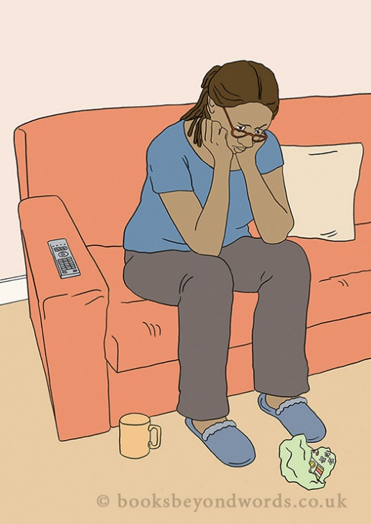
Complicated Grief: Diagnostic Criteria (Prigerson, 1999)
Separation Distress
Intrusive thoughts
Yearning
Searching
Excessive loneliness.
Traumatic Distress
Purposelessness
Sense of numbness
Disbelief
Emptiness
Shattered world view
Irritability, bitterness, anger
Avoidance
Stunned, shock.
Notes:
Expert Group: Prigerson, Zisook, Kupfer.
Complicated Grief is a stress response syndrome-many symptoms come to resemble symptoms of P.T.S.D.
Development of Consensus Criteria: 6 month assessment of grief had good predictive value of adverse mental symptoms; suggested that 2 months duration of symptoms would be appropriate.
In addition, there must be social and occupational impairment
Separation Distress: The group agreed that symptoms of separation distress were at the core of this grief related disorder;lonliness included because it was found to be closely associated with impairments in social functioning and physical health.
Traumatic Distress: The panel decided to incorporate the symptoms of being traumatised by loss into a single cluster. These symptoms were intended to represent bereavement specific manifestations of being traumatised by the death.

Slide 5
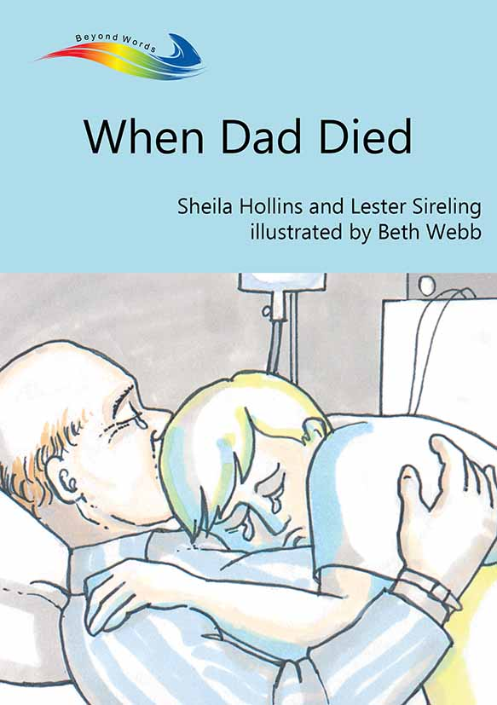
1989: ‘When Mum Died’ and ‘When Dad Died’ published
No books available for adults who find pictures easier than words to explain death and dying
No resources available that recognised an inner emotional world

Slide 6
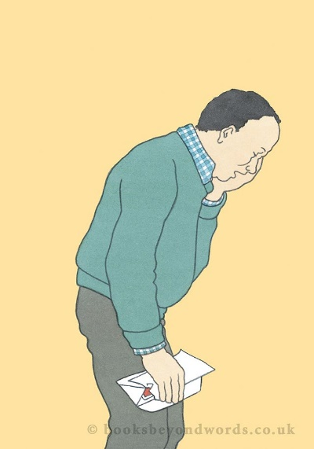
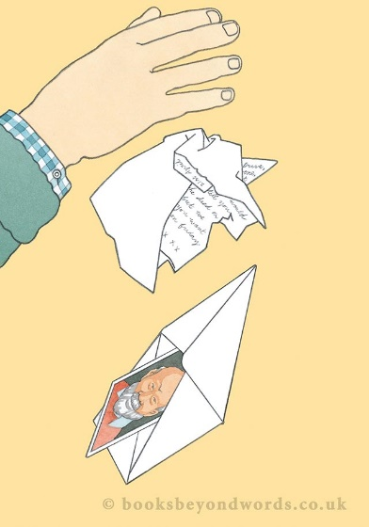
A STUDY TO UNDERSTAND THE EFFECT OF BEREAVEMENT ON BEHAVIOUR AND MENTAL HEALTH in 50 non-bereaved adults and 50 parentally bereaved adults within previous 2 years
1. Comparing behaviour, mental health, life events
2. A description of their bereavement experiences
A comparison of behaviour and mental health of those who had been bereaved at 2 points:
- initially (Hollins & Esterhuyen 1997) - and at 5 year follow up (Bonell-Pascual 1999)
Notes:
HOLLINS, S. and ESTERHUYZEN, A. (1997) Bereavement and Grief in adults with learning disabilities. British Journal of Psychiatry 170, 497-501.
BONELL-PASCUAL, E., HULINE-DICKENS, S., HOLLINS, S., ESTERHUYZEN, A., SEDGWICK, P., ABDELNOOR, A. and HUBERT, J. (1999)

Slide 7
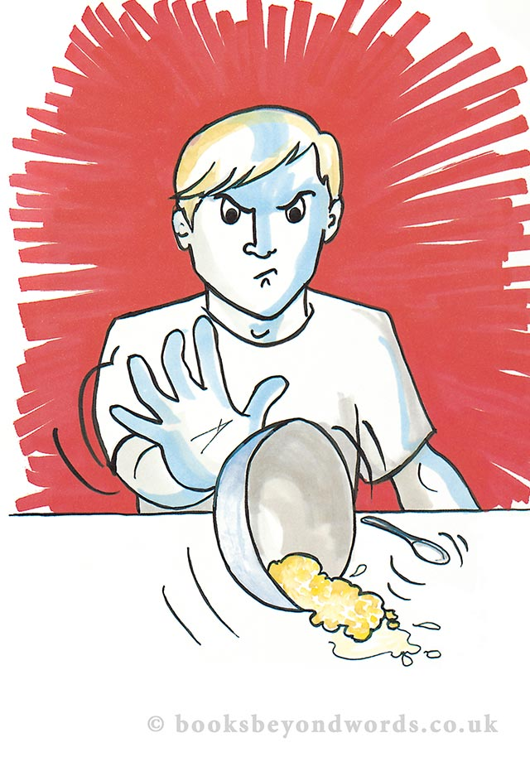
Comparing behaviour, mental health, life events in the 2 groups
Compared with the non bereaved controls the bereaved people were significantly more:
depressed, anxious, lethargic
irritable, hyperactive
unable to adjust, and talking ‘inappropriately’ about the parent who had died

Slide 8
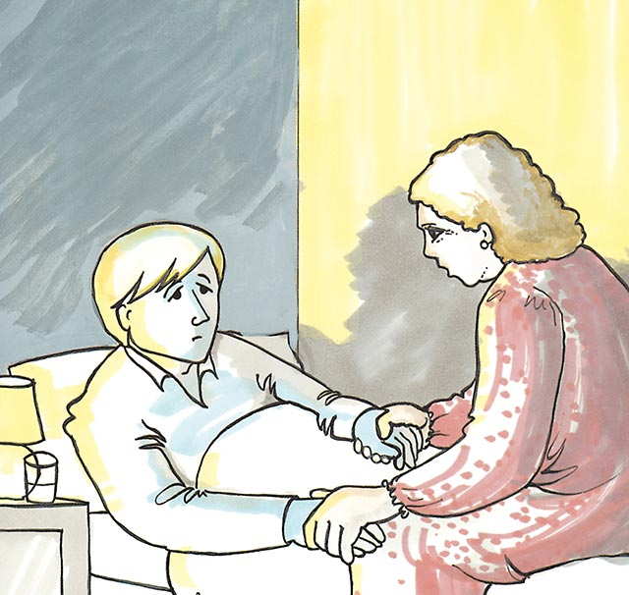
Comparing life events
since the bereavement
About 1 in 4 of the bereaved people moved home compared with 1 in 10 of the controls
About 1 in 3 of the bereaved people were separated from another significant person compared with no such separations in the controls

Slide 9
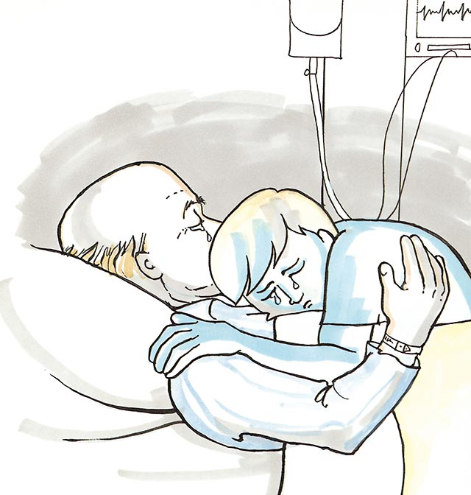
FEW OPPORTUNITIES FOR GRIEVING
ONLY 1 in 6 people visited their sick parent
2/3rds lived together until parent became ill, but less than a third by the time of death
ONLY 1 in 4 had an opportunity to say goodbye
ONLY about half attended funeral

Slide 10
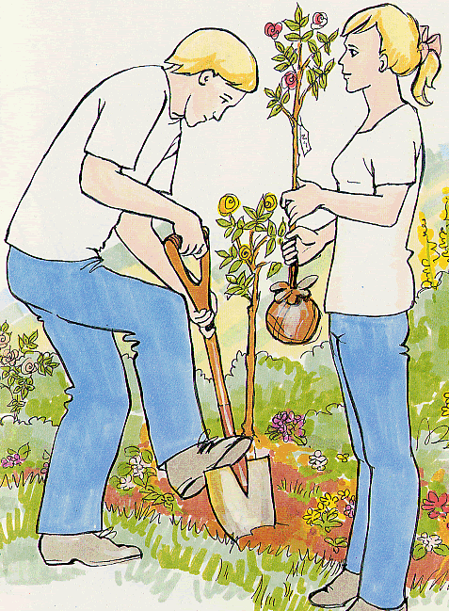
OPPORTUNITIES FOR GRIEVING
ONLY 1 in 6 people visited grave
MOST carer’s (70%) said person not affected by their parent’s death
2/3rds still talked about the parent
who had died
7 out of 10 had a memento
ONLY 1 in 7 had any bereavement
counselling

Slide 11
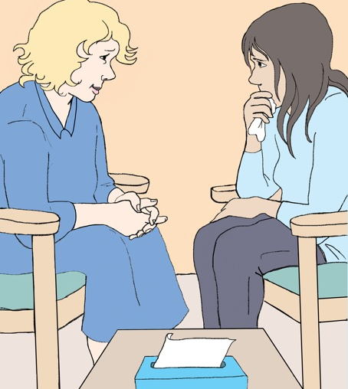
An intervention study to compare 2 different interventions Dowling et al, 2005
1. A TRADITIONAL COUNSELLING INTERVENTION
Commonly used in bereavement counselling
Collaboration with CRUSE bereavement care and local bereavement services
Participants offered up to twelve counselling sessions over a six month period

Slide 12
2. AN INTEGRATED INTERVENTION IN DAILY LIFE
Developed from Stroebe and Schut (1998) Theoretical Dual Process Model.
Focusing on both loss and restoration as necessary components of grieving
Delivered by people who participants see daily at home or in daytime activities

Slide 13
A Dual Process Model of Coping with Loss: Stroebe and Schut (1998)
Everyday life experience
Loss-oriented
Restoration-oriented
grief work
intrusion of grief
breaking bonds/ties
denial/avoidance of restoration changes
attending to life changes
doing new things
distraction from grief
denial/avoidance of grief
new roles/identity/
relationships

Slide 14
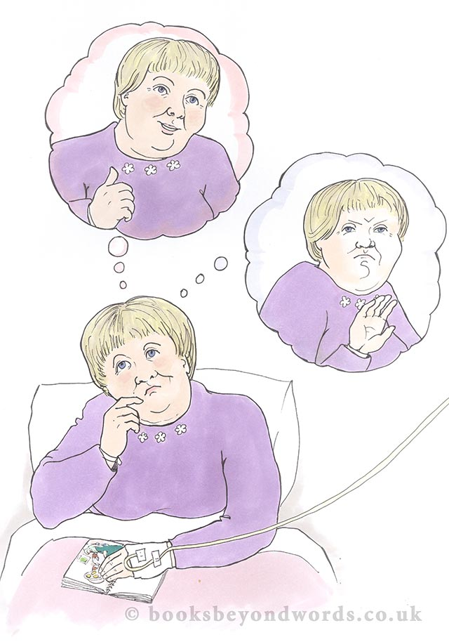
STUDY PARTICIPANTS
56 bereaved people with learning disabilities
33 allocated to counselling intervention
23 allocated to integrated intervention by usual learning disability staff

Slide 15
RESULTS FROM THE TWO DIFFERENT INTERVENTIONS
After the intervention by bereavement counsellors the high pre-intervention scores for mental health and behaviour had returned to normal
But after the intervention offered by a person’s usual learning disability support staff, there was no change in the pre-intervention scores
NB. The standardised questionnaires used were the ABC and PIMRA
All results were significant at 5% level

Slide 16
INTERVAL – Grassroots video

Slide 17
Managing Grief Better - Prevention
Key Points for Caregivers:
1. Listen, be there with the grieving person.
2. Be honest, include and involve them, e.g. in funeral.
3. Minimise changes after any loss.
4. Avoid assessing skills until grief has resolved.
5. Choose non-verbal rituals, such as music, mime or flowers.

Slide 18
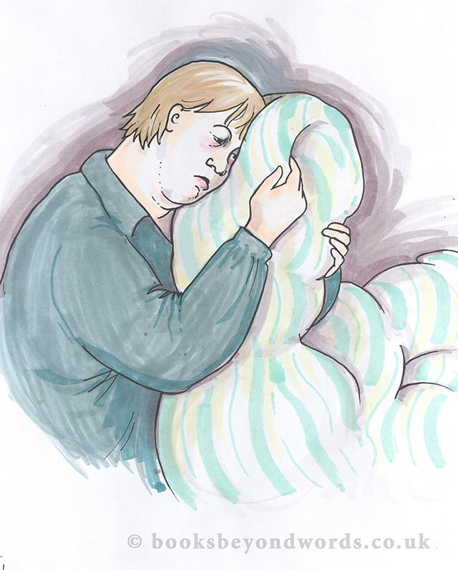
Listen, be there with the grieving person
Watch and wonder
Learn to listen:
to non-verbal communications indicating pain or anxiety
sounds
body positions
facial gestures
other non-verbal signs

Slide 19
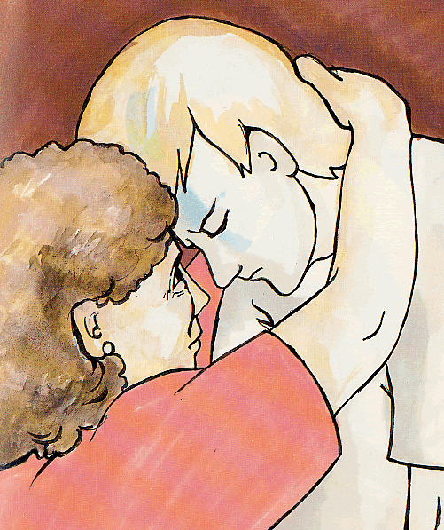
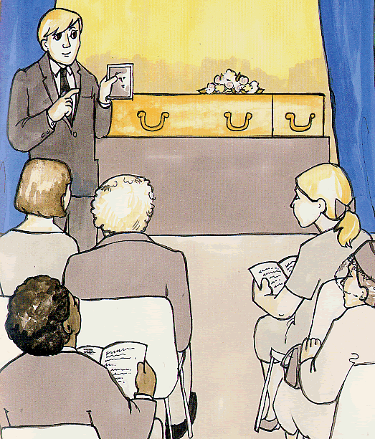
Be honest, include and involve them e.g. in funeral rituals
Be honest:
Explain
Use pictures and stories

Slide 20
Managing Grief Better
6. Respect photos and mementoes of the person’s own choice.
7. Assist visits to familiar places in “search” of the lost person.
8. Seek specialist consultation if behavioural changes persist.
9. Help to remember important anniversaries.
10. Adapt these key points for other losses.

Slide 21
Respect photos and mementoes of the person’s own choice
Let them choose what has meaning for them
Take time together to remember the person who died

Slide 22
Help to remember important anniversaries Assist visits to familiar places
For example
Go on holiday to a place that you all went together

Slide 23
Avoid assessing skills or making changes until grief has resolved
Watch for any changes in behavior
Wonder if any changes indicate grief that hasn’t been recognised
Notes:
Eg to reduce sensory overload

Slide 24
Events most commonly rated by adults with IDD as having negative impact: mapped to Books Beyond Words (adapted from Hulbert-Williams 2014 - Copyright © Bradley, Hollins, Korossy, Levitas, 2017)
Event | Books Beyond Words title
35% Permanent change in staffing | A new home in the community, Ann has dementia
24% Other person moved into or out of house/flat/unit | Jenny Speaks Out
22% Period of cover by non-regular carer | Feeling Cross and Sorting it Out
19% Serious illness or injury not requiring hospitalisation | Going to the doctor; Going to outpatients; Am I going to die
16% Separation from friend/family/long-term carer | A new home in the community When Dad Died, When Mum Died When Somebody Dies
13% Moved house | Peter’s new home
12% Change in daily routine | George gets smart

Slide 25
Bereavement research at St George’s
HOLLINS, S. and ESTERHUYZEN, A. (1997) Bereavement and Grief in adults with learning disabilities. British Journal of Psychiatry 170, 497-501.
BONELL-PASCUAL, E., HULINE-DICKENS, S., HOLLINS, S., ESTERHUYZEN, A., SEDGWICK, P., ABDELNOOR, A. and HUBERT, J. (1999) Bereavement and Grief in Adults with Learning Disabilities: A follow up study. British Journal of Psychiatry 175, 348-350.
HOLLINS, S. (2000) Author’s reply to C.A. Lyons’ response to Bonell-Pascual, E., Huline-Dickens, S., Hollins, S., et al (1999) Bereavement and grief in adults with learning disabilities. A follow-up study. BJPsych 175, 348-350. British Journal of Psychiatry 176, 297-298
DOWLING, D., HUBERT, J. AND HOLLINS, S. (2003) Bereavement interventions for people with learning disabilities: 'My mother's name was Marjorie'. Bereavement Care 22, 19-21.
DOWLING, S. and HOLLINS, S. (2003) Coping with bereavement: the dynamics of intervention. In: Davidson, P. W., Prasher V. P. and Janicki, M. P. (eds), Mental Health Intellectual Disabilities and the Ageing Process. London: Blackwell.
DODD, P., DOWLING, S. and HOLLINS, S. (2005) A Review of the Emotional, Psychiatric and Behavioural Responses to Bereavement in People with Intellectual Disabilities. Journal of Intellectual Disability Research 49 (7), 537-543.
DOWLING, S., HUBERT, J., WHITE, S. and HOLLINS, S. (2005) Bereaved adults with intellectual disabilities: a combined randomized controlled trial and qualitative study of two community-based interventions Journal of Intellectual Disability Research Available online https://onlinelibrary.wiley.com/doi/pdf/10.1111/j.1365-2788.2005.00759.x

Slide 26
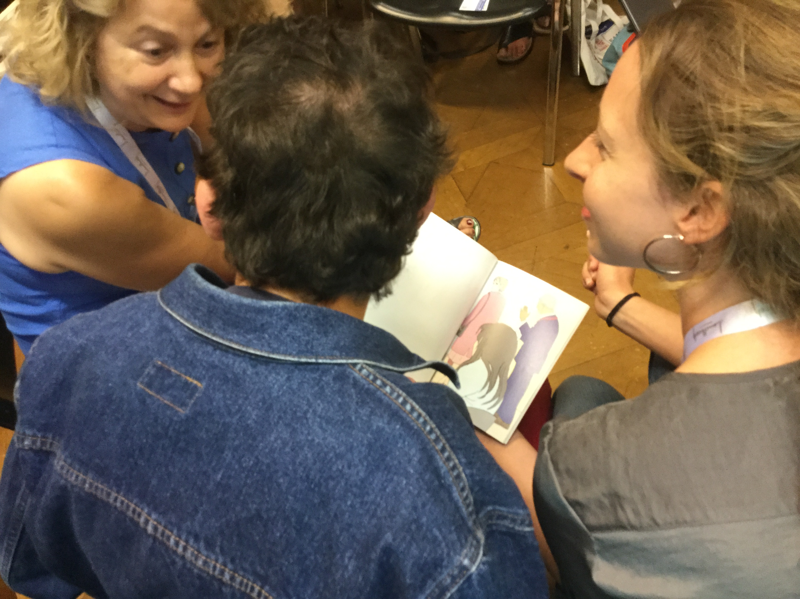
Pictures in this presentation are from Books Beyond Words
Get an App licence
An e-learning course, Webinars, Mentoring
Read Books Beyond Words online (ZOOM) or in a public library, school or College
Set up health and wellness or death café style groups

Slide 27
Some free downloadable resources to get you started!

Slide 28
For books and videos
www.booksbeyondwords.co.uk

